Slide 1
Data Analytics, Nonlinear Dynamics, and Chaotic Systems
Hui Yang and Yun Chen
Complex Systems Monitoring, Modeling and Analysis Laboratory
University of South Florida

Slide 2
Relevant Publications
H. Yang, Y. Chen, and F. M. Leonelli, “Characterization and Monitoring of Nonlinear Dynamics and Chaos in Complex Physiological Signals,” Healthcare Analytics, Eds: H. Yang and E. K. Lee, Wiley, March 7, 2016, pp. 59-93, DOI: 10.1002/9781118919408.ch3
B. Yao†, F. Imani†, A. Sakpal†, E. W. Reutzel, and H. Yang*, “Multifractal analysis of image profiles for the characterization and detection of defects in additive manufacturing,” ASME Journal of Manufacturing Science and Engineering, Vol. 140, No. 3, 2017, DOI: 10.1115/1.4037891
F. Imani†, B. Yao, R. Chen, P. Rao, and H. Yang*, “Fractal Pattern Recognition of Image Profiles for Manufacturing Process Monitoring and Control”, Proceedings of NAMRC/MSEC 2018, June 18-22, College Station, TX. DOI: 10.1115/MSEC2018-6523
Y. Chen† and H. Yang*, "A comparative analysis of alternative approaches for exploiting nonlinear dynamics in the heart rate time series " Proceedings of 2013 IEEE Engineering in Medicine and Biology Society Conference (EMBC), p. 2599-2602, July 3-7, 2013, Osaka, Japan. DOI: 10.1109/EMBC.2013.6610072

Slide 3
Outline
Introduction
Dynamical System
Takens Embedding Theorem
Time delay - mutual information
Embedding dimension - false nearest neighbors
Chaos – Fractal and Recurrence
Notes:
Before the presentation gets started, let’s have a look at the outline.
In the first place, I will talk about research motivation and problem statement.
Next, I will introduce the research background including self-similarity and recurrence dynamics in the heart rhythm
Then we will move to the section of research methodology and experimental results.
In the end I will conclude today’s talk.

Slide 4
Data
Systems
Sensors
DATA
INFORMATICS
We naturally love and accept
But, in the face of a world that is largely
Synthetic
Linear
Stationary
Clean
Continuous
Natural
Nonlinear
Nonstationary
Noise
intermittent
Switching

Slide 5
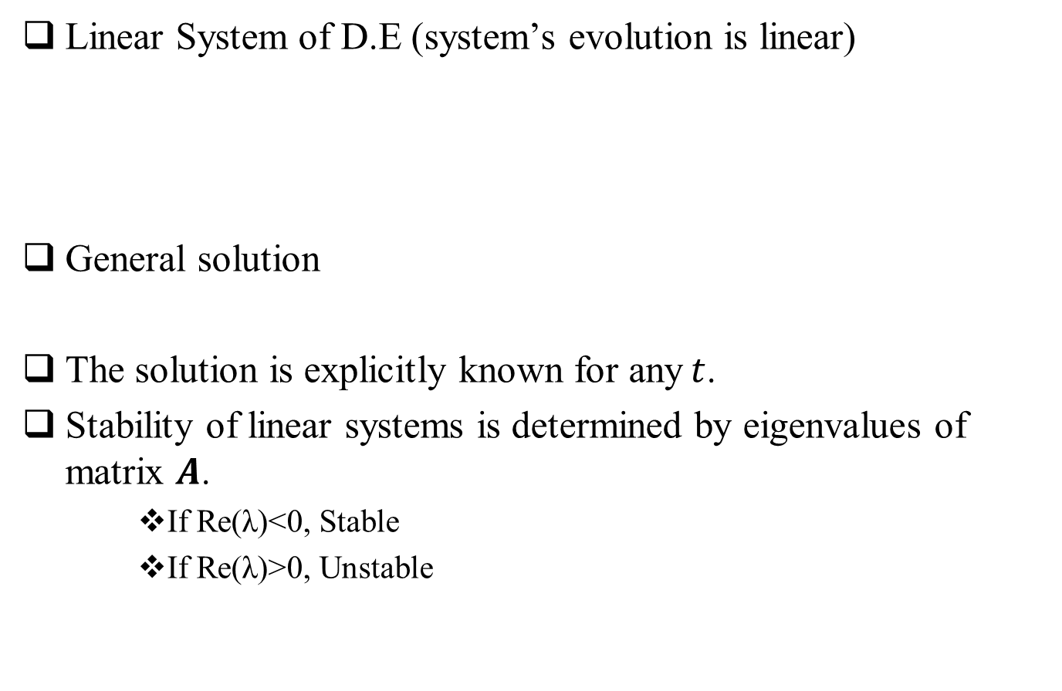
Linear Systems
Linear System of D.E (system’s evolution is linear)
General solution
The solution is explicitly known for any$t$.
Stability of linear systems is determined by eigenvalues of matrix $A$.
If Re(λ)<0, Stable
If Re(λ)>0, Unstable

Slide 6
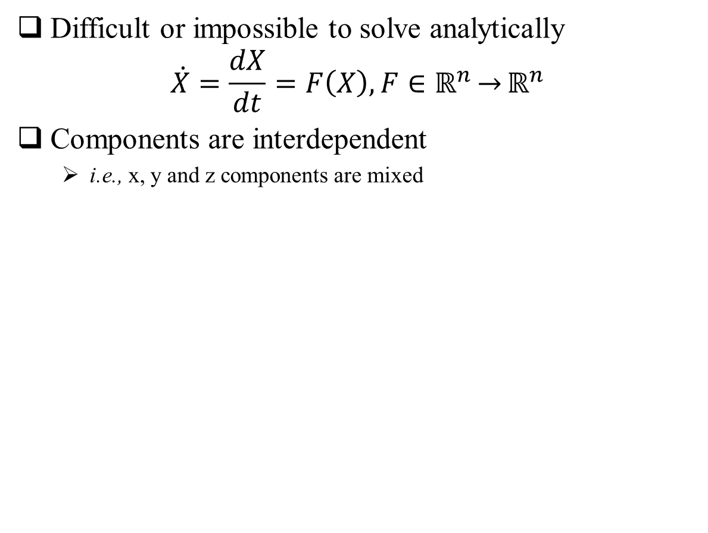
Nonlinear Systems
Difficult or impossible to solve analytically
$$\dot{X}=\frac{dX}{dt}=F\left(X\right), F∈ℝ^{n}\underset{→}{}ℝ^{n}$$
Components are interdependent
i.e., x, y and z components are mixed
Edward Lorenz
Atmospheric convection
Otto Rössler
Modeling equilibrium in chemical reactions

Slide 7
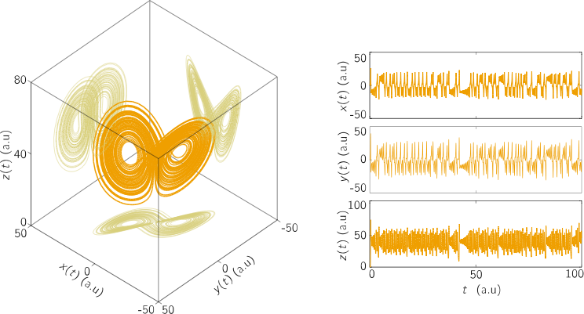
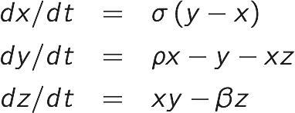
Visualization: Strange Attractors
State Space Representation
The evolution of the state variable can be represented as 1D time series
Evolution of the state variable can be represented simultaneously in a m-dimensional phase space.
Lorenz Attractor (3D nonlinear system)
Lorenz’s Model

Slide 8
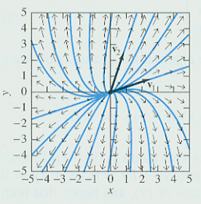
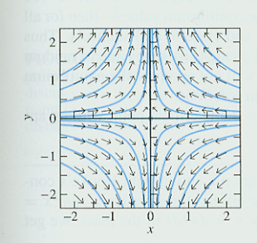
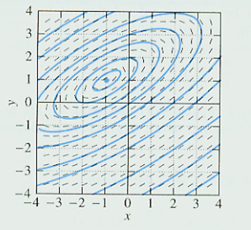
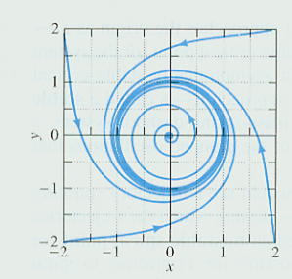
Qualitative Analysis
State space representation
Find the critical points (A.k.a., equilibrium points)
Describe the nature of the solution curves around the critical points
Make approximations (Jacobian Matrix)
Node Saddle Center Spiral

Slide 9
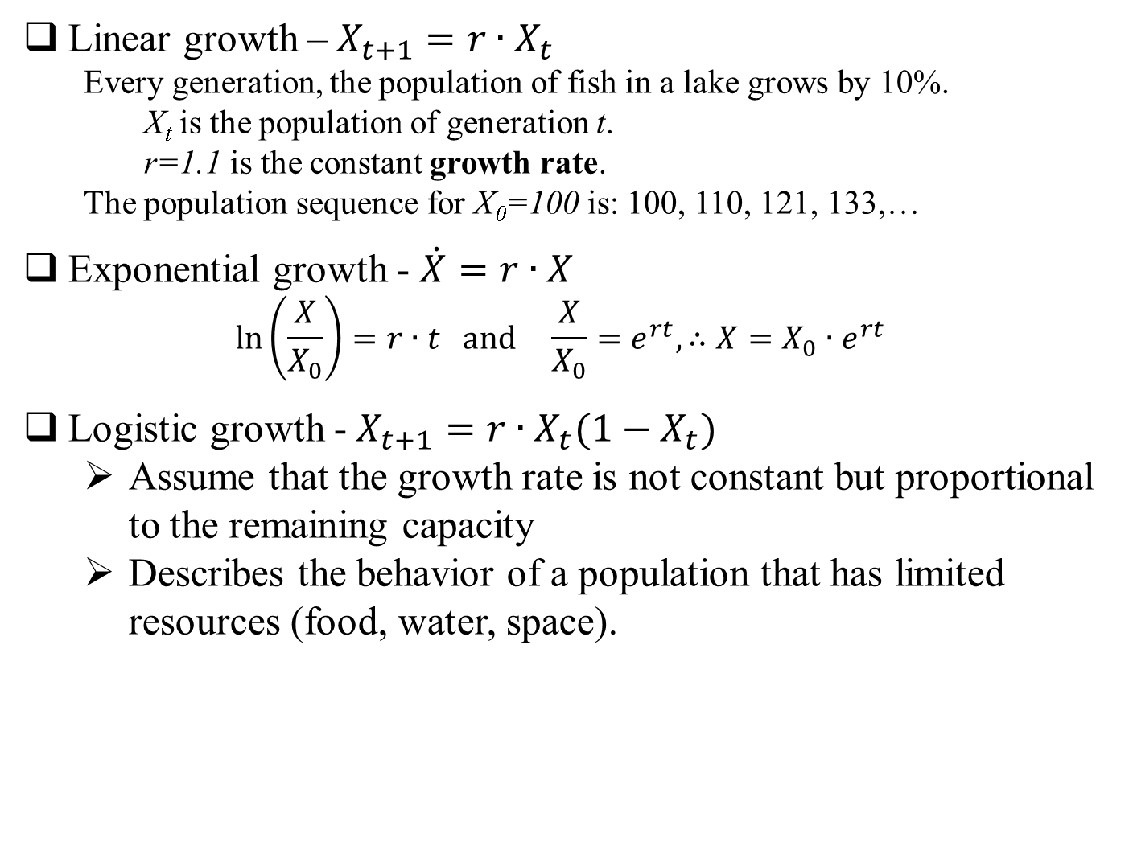
Logistic Map
Linear growth – $X_{t+1}=r∙X_{t}$
Every generation, the population of fish in a lake grows by 10%.
X_{t} is the population of generation t.
r=1.1 is the constant growth rate.
The population sequence for X₀=100 is: 100, 110, 121, 133,…
Exponential growth - $\dot{X}=r∙X$
$$\ln\left(\frac{X}{X_{0}}\right)=r∙t and \frac{X}{X_{0}}=e^{rt}, ∴X=X_{0}∙e^{rt}$$
Logistic growth -$X_{t+1}=r∙X_{t}(1−X_{t})$
Assume that the growth rate is not constant but proportional to the remaining capacity
Describes the behavior of a population that has limited resources (food, water, space).
predictable systems with analytical solns
nonlinear dynamics
Not predictable

Slide 10
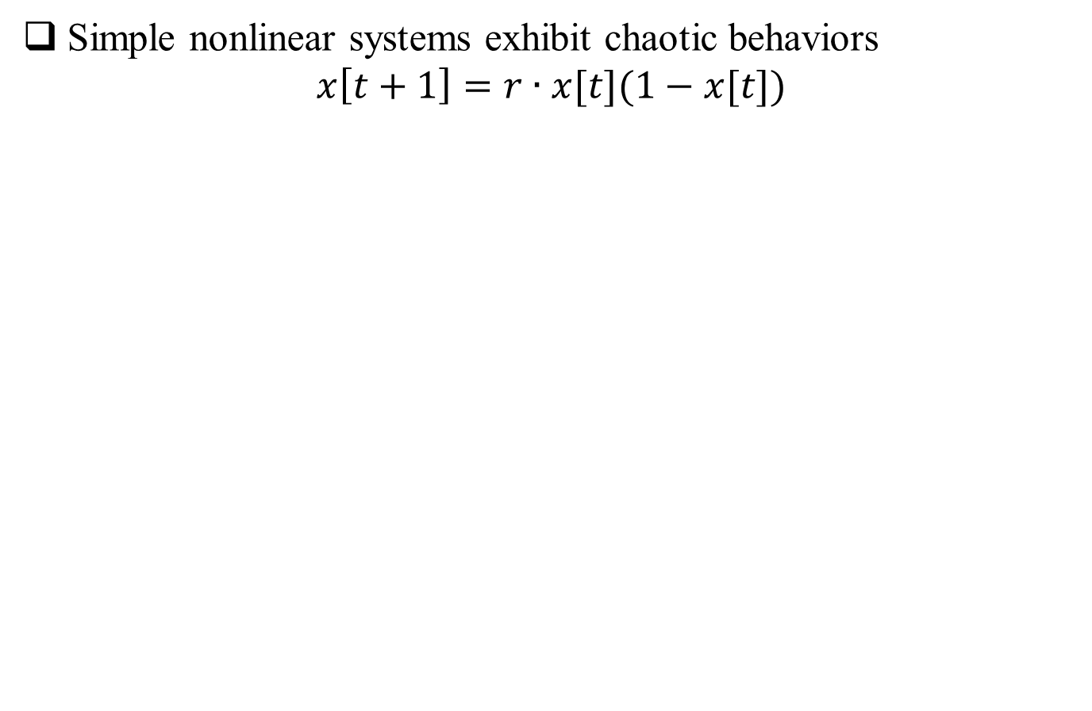
Logistic Map
Simple nonlinear systems exhibit chaotic behaviors
$$x\left[t+1\right]=r∙x[t](1−x[t])$$

Slide 11
Logistic Map

Slide 12
Logistic Map
Notes:
Gets very close to K but doesn’t stay there.
What’s worse is that there is no pattern.
Is it just repeating over very long timescales?
[Will get periodicity due to truncation of computer calculations,
but if could use real numbers, no periodicity.
With double-precision arithmetic, cycles exceed a billion iterations.]
Turns out to be no pattern at all – this is CHAOS.
No cycle – chaotic attractor or strange attractor.

Slide 13
Logistic Map

Slide 14
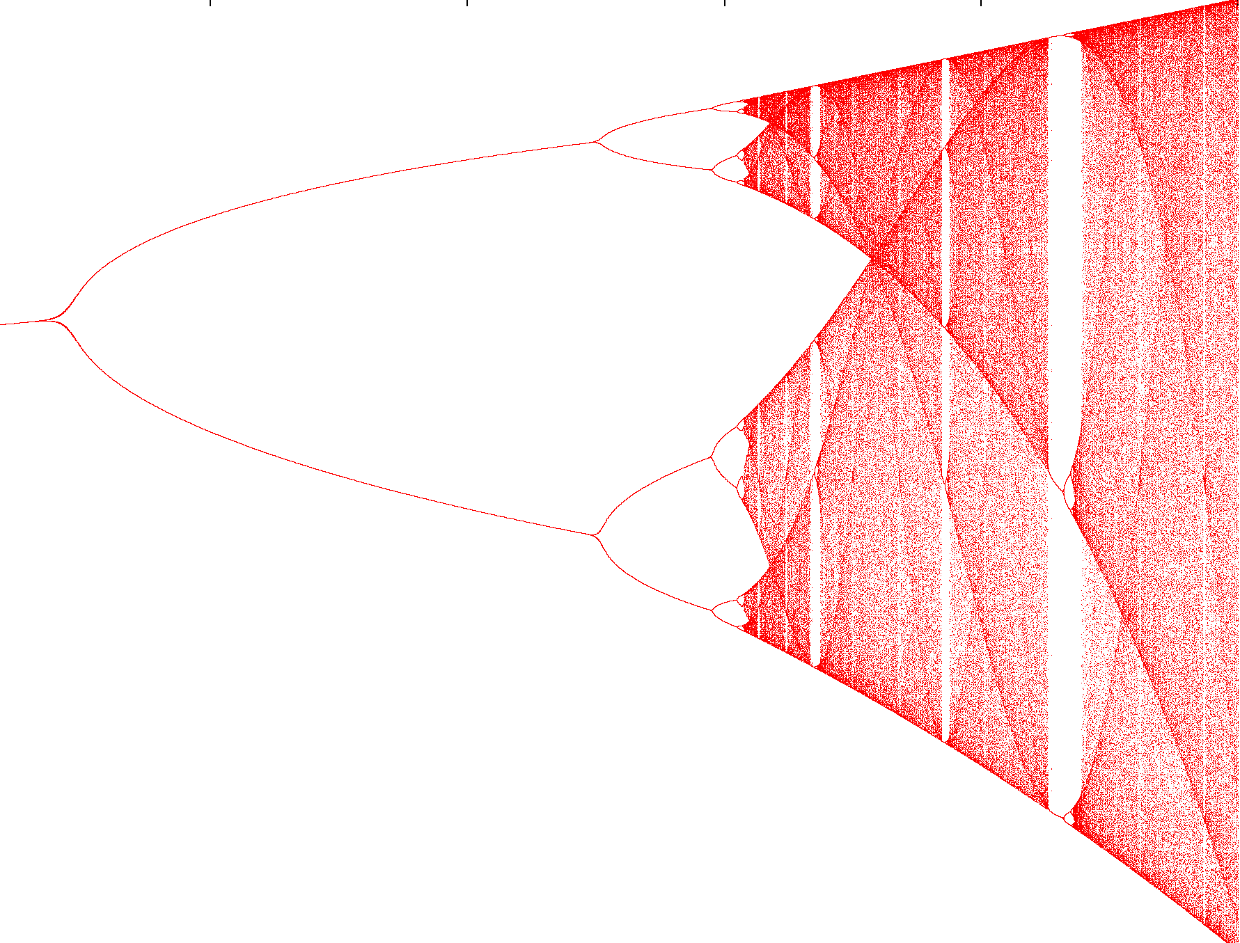
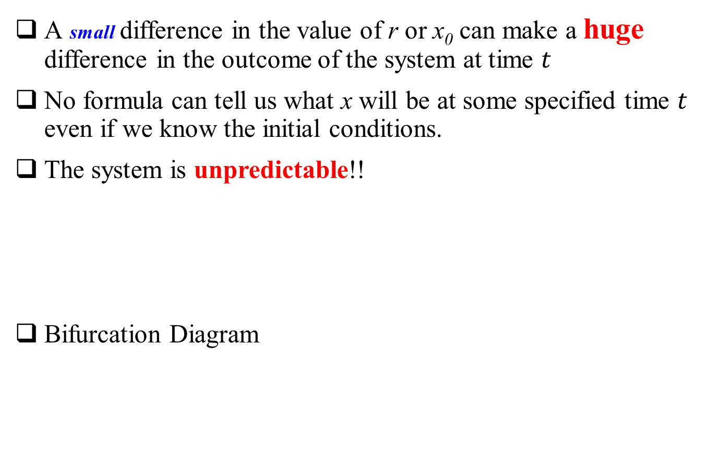
Logistic Map
A small difference in the value of r or x₀ can make a huge difference in the outcome of the system at time $t$
No formula can tell us what x will be at some specified time $t$ even if we know the initial conditions.
The system is unpredictable!!
Bifurcation Diagram
Sensitive Dependence on Initial Conditions
possible long-term values of a system as a function of a bifurcation parameter in the system

Slide 15
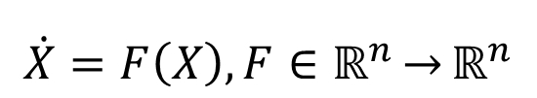
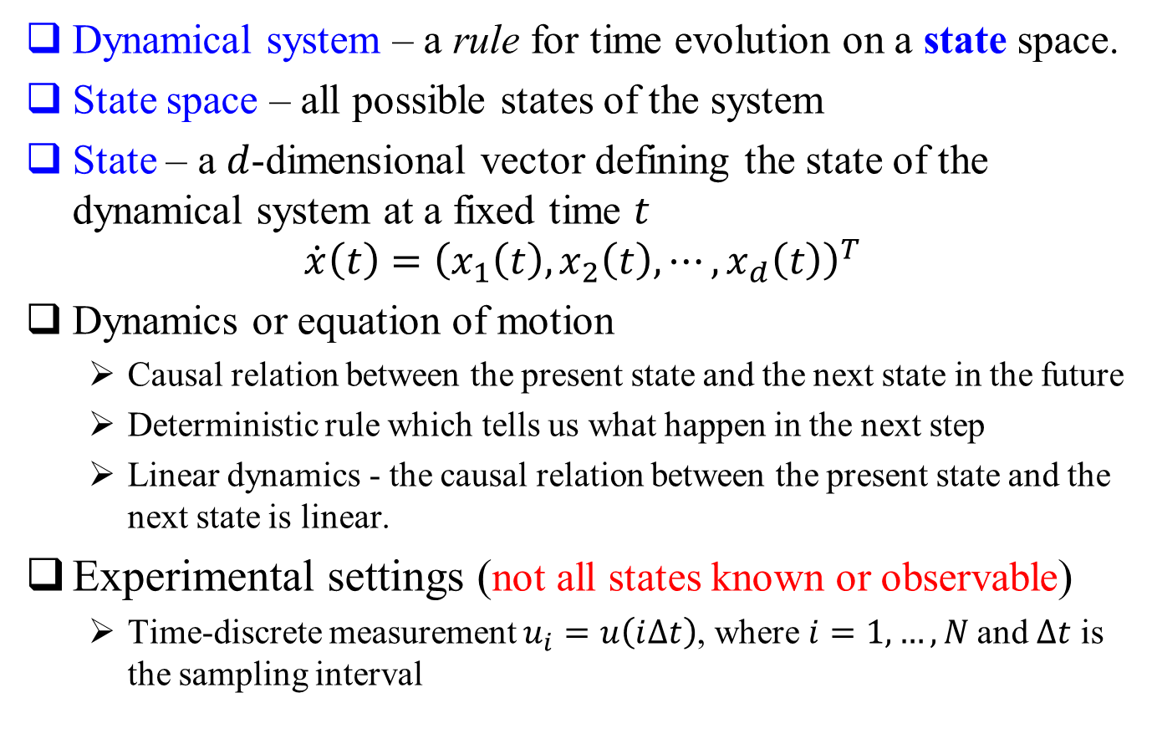
Nonlinear Dynamics
Dynamical system – a rule for time evolution on a state space.
State space – all possible states of the system
State – a $d$-dimensional vector defining the state of the dynamical system at a fixed time $t$
$$\dot{x}\left(t\right)={\left(x_{1}\left(t\right),x_{2}\left(t\right),⋯,x_{d}\left(t\right)\right)}^{T}$$
Dynamics or equation of motion
Causal relation between the present state and the next state in the future
Deterministic rule which tells us what happen in the next step
Linear dynamics - the causal relation between the present state and the next state is linear.
Experimental settings (not all states known or observable)
Time-discrete measurement $u_{i}=u\left(i∆t\right)$, where $i=1,…,N$and $∆t$ is the sampling interval
$$\dot{X}=F\left(X\right), F∈ℝ^{n}\underset{→}{}ℝ^{n}$$

Slide 16
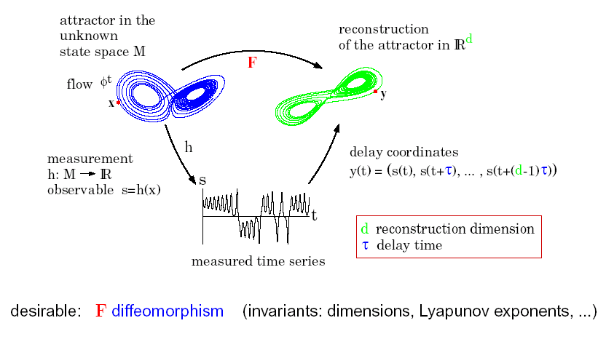
State Space Reconstruction

Slide 17
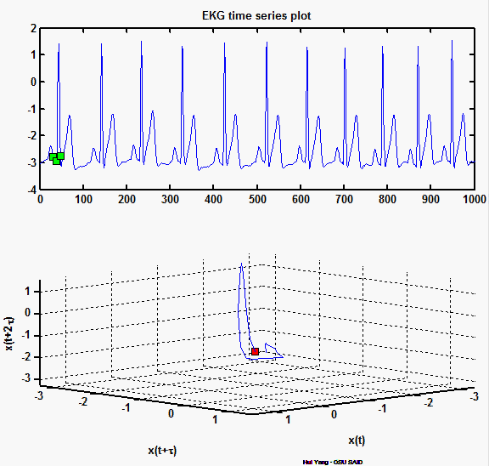
An Example

Slide 18
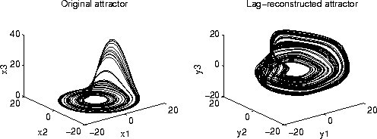
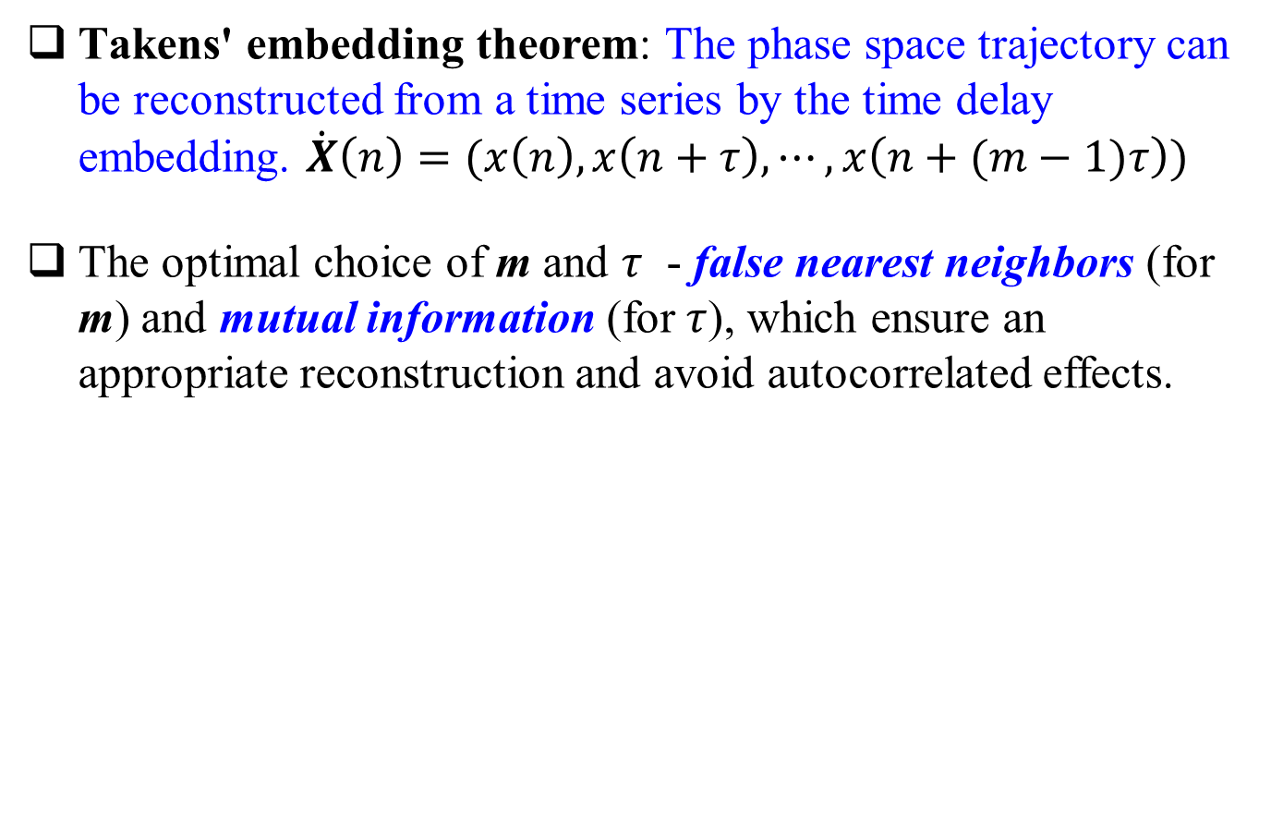
Takens' embedding theorem
Takens' embedding theorem: The phase space trajectory can be reconstructed from a time series by the time delay embedding. $\dot{X}\left(n\right)=(x\left(n\right),x\left(n+τ\right),⋯,x\left(n+(m−1)τ\right))$
The optimal choice of m and $τ$ - false nearest neighbors (for m) and mutual information (for$τ$), which ensure an appropriate reconstruction and avoid autocorrelated effects.
Represent the same dynamical system in different coordinate systems

Slide 19
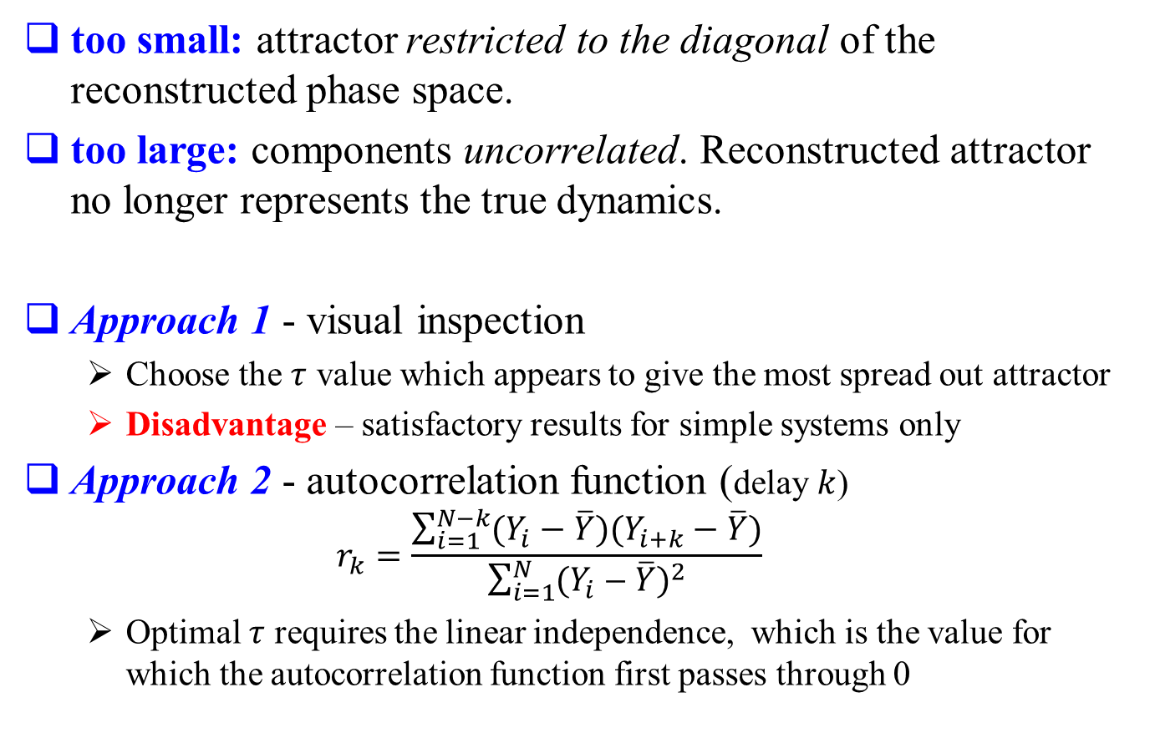
Time Delay
too small: attractor restricted to the diagonal of the reconstructed phase space.
too large: components uncorrelated. Reconstructed attractor no longer represents the true dynamics.
Approach 1 - visual inspection
Choose the $τ$ value which appears to give the most spread out attractor
Disadvantage – satisfactory results for simple systems only
Approach 2 - autocorrelation function (delay $k$)
$$r_{k}=\frac{\sum_{i=1}^{N−k}{(Y_{i}−\overline{Y})(Y_{i+k}−\overline{Y})}}{\sum_{i=1}^{N}{{(Y_{i}−\overline{Y})}^{2}}}$$
Optimal $τ$ requires the linear independence, which is the value for which the autocorrelation function first passes through 0

Slide 20
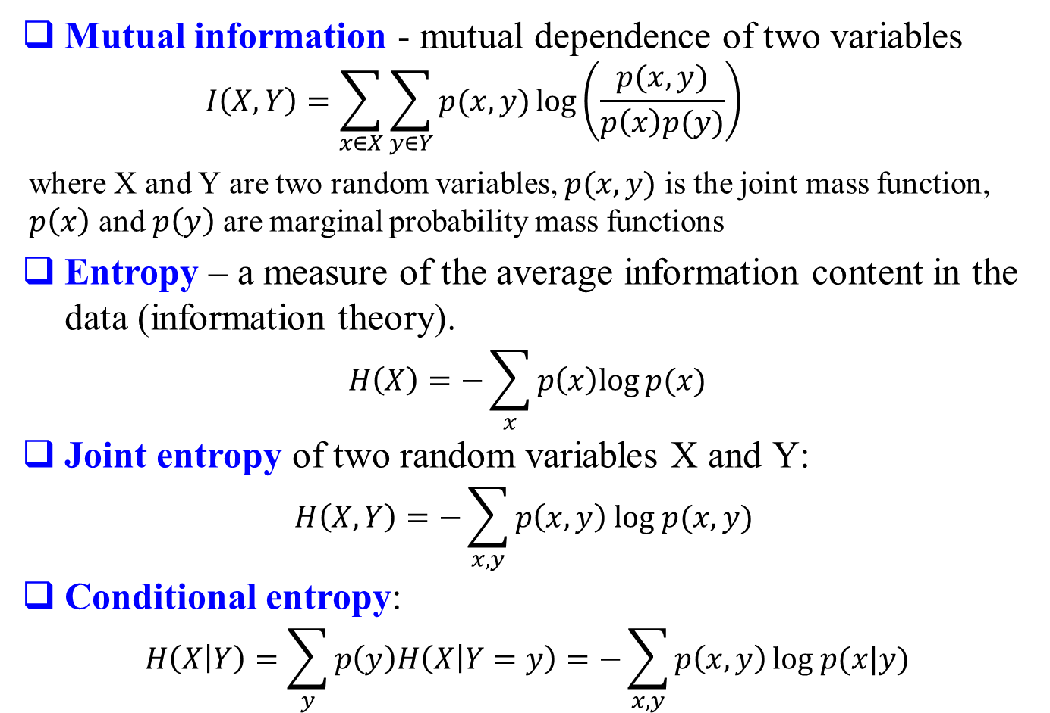
Mutual Information
Mutual information - mutual dependence of two variables
$$I\left(X,Y\right)=\sum_{x∈X}{\sum_{y∈Y}{p(x,y)\log\left(\frac{p(x,y)}{p\left(x\right)p(y)}\right)}}$$
where X and Y are two random variables, $p(x,y)$ is the joint mass function, $p\left(x\right)$ and $p\left(y\right)$ are marginal probability mass functions
Entropy – a measure of the average information content in the data (information theory).
$$H\left(X\right)=−\sum_{x}{p\left(x\right)log⁡p(x)}$$
Joint entropy of two random variables X and Y:
$$H\left(X,Y\right)=−\sum_{x,y}{p\left(x,y\right) log p(x,y) }$$
Conditional entropy:
$$H\left(X | Y\right)=\sum_{y}{p\left(y\right)H\left(X | Y=y\right)=−\sum_{x,y}{p\left(x,y\right)}log p(x|y)}$$

Slide 21
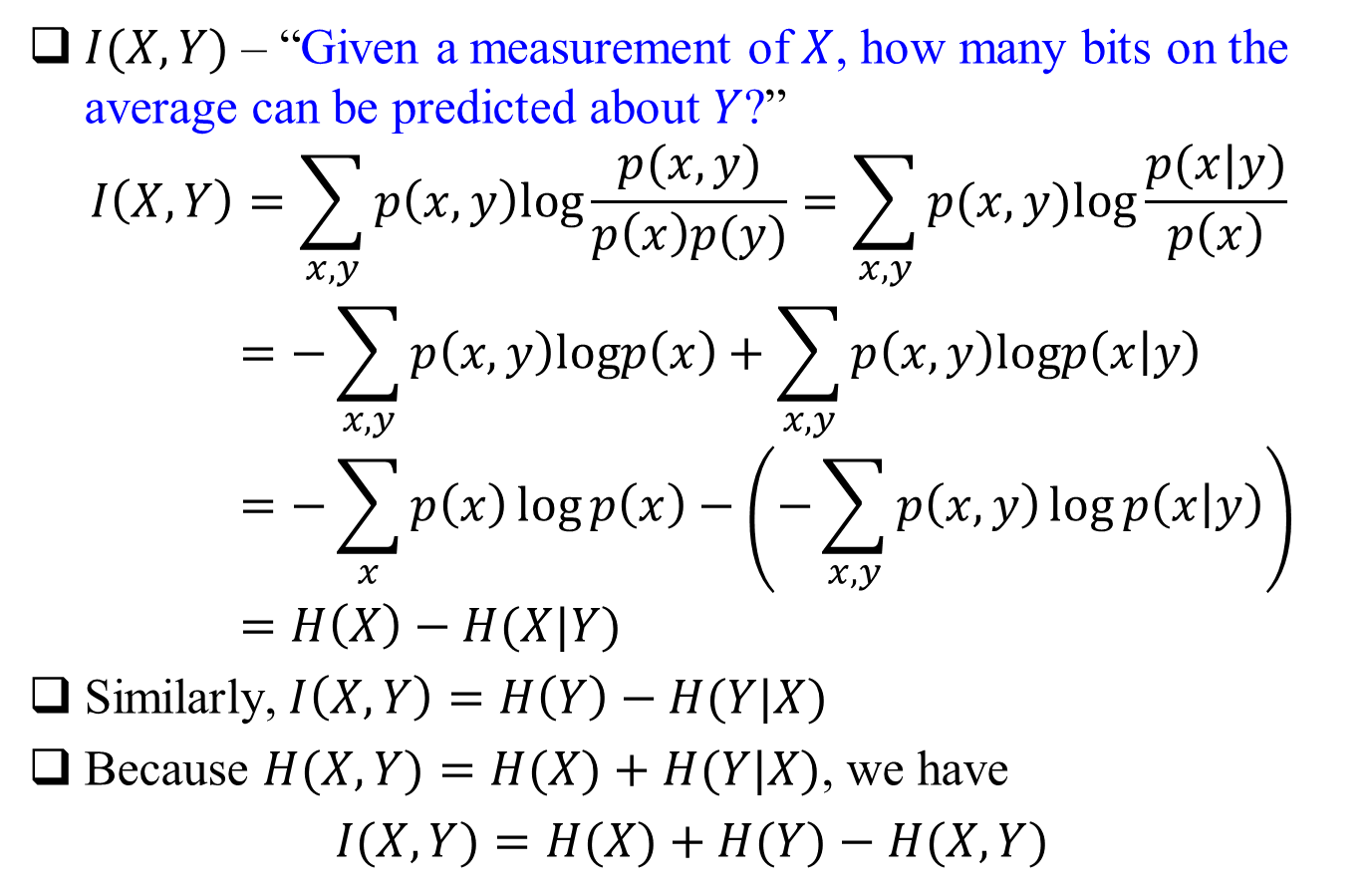
Mutual Information
$I(X,Y)$ – “Given a measurement of $X$, how many bits on the average can be predicted about $Y$?”
$$I\left(X,Y\right)=\sum_{x,y}{p\left(x,y\right)log\frac{p(x,y)}{p\left(x\right)p(y)}}=\sum_{x,y}{p(x,y)log\frac{p(x|y)}{p\left(x\right)}}=−\sum_{x,y}{p\left(x,y\right)logp\left(x\right)+\sum_{x,y}{p\left(x,y\right)logp\left(x | y\right)}}=−\sum_{x}{p\left(x\right)\log{p\left(x\right)}−\left(−\sum_{x,y}{p\left(x,y\right)\log{p\left(x | y\right)}}\right)}=H\left(X\right)−H(X|Y)$$
Similarly,$I\left(X,Y\right)=H\left(Y\right)−H(Y|X)$
Because $H(X,Y)=H(X)+H(Y|X)$, we have
$$I(X,Y)=H(X)+H(Y)−H(X,Y)$$

Slide 22
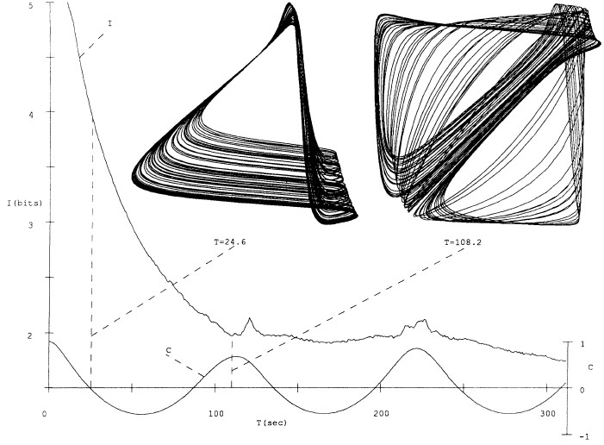
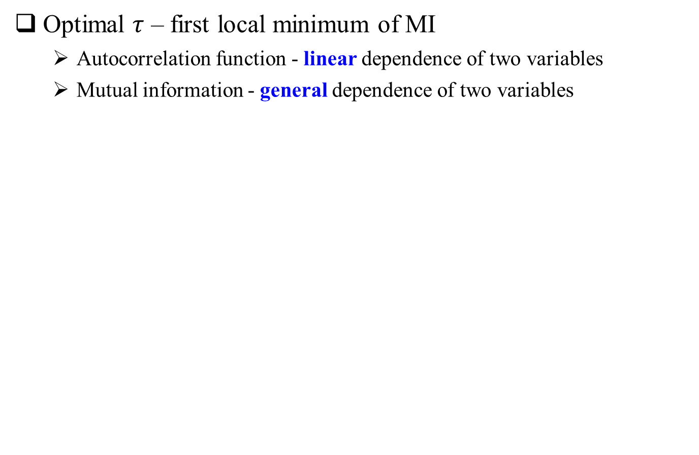
Mutual Information
Optimal $τ$ – first local minimum of MI
Autocorrelation function - linear dependence of two variables
Mutual information - general dependence of two variables
Roux attractor

Slide 23
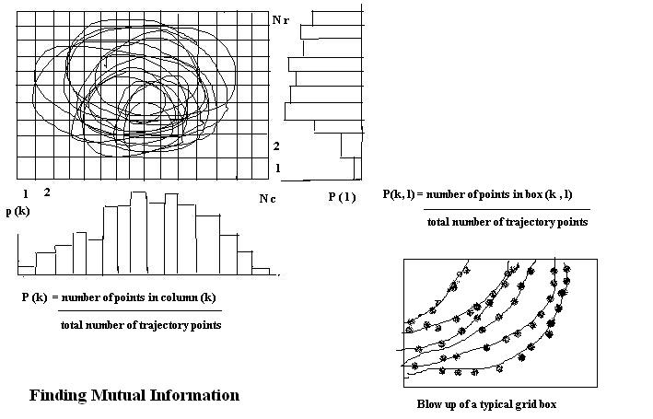
Practical Implementation

Slide 24
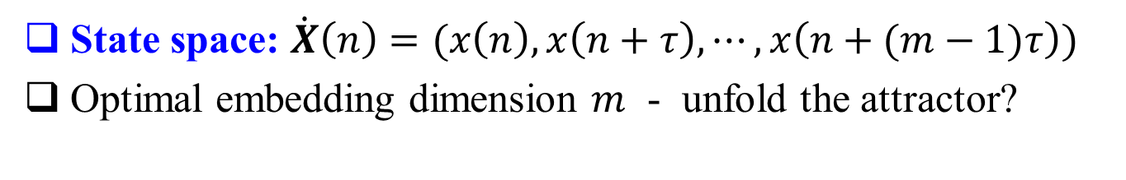
Embedding Dimension
State space: $\dot{X}\left(n\right)=(x\left(n\right),x\left(n+τ\right),⋯,x\left(n+(m−1)τ\right))$
Optimal embedding dimension $m$ - unfold the attractor?
The minimal dimension is required to reconstruct the system without any information being lost but without adding unnecessary information.
A larger dimension than the minimum leads to excessive computation when investigating the dynamical properties.
“Noise” will populate and dominate the extra dimension of the space where no dynamics is operating.
X
k
Notes:
Before the presentation gets started, let’s have a look at the outline.
In the first place, I will talk about research motivation and problem statement.
Next, I will introduce the research background including self-similarity and recurrence dynamics in the heart rhythm
Then we will move to the section of research methodology and experimental results.
In the end I will conclude today’s talk.

Slide 25
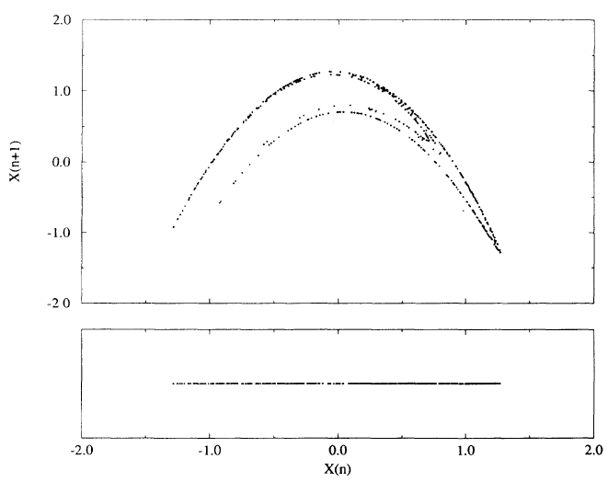
False Nearest Neighbors
Idea: Measure the distances between a point and its nearest neighbor, as this dimension increases, this distance should not change if the points are really nearest neighbors.
B
A
C
B
A
C

Slide 26
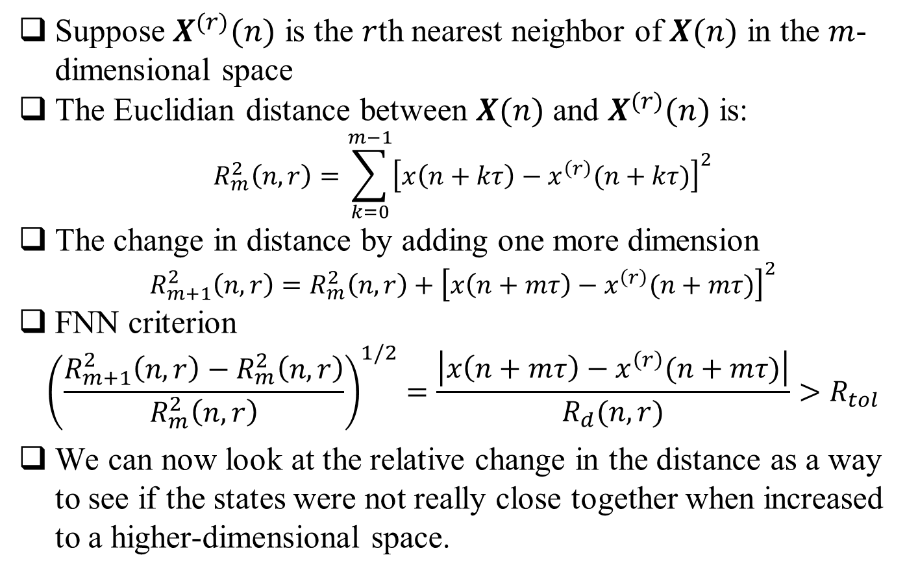
False Nearest Neighbors
Suppose $X^{(r)}(n)$ is the $r$th nearest neighbor of $X(n)$ in the $m$-dimensional space
The Euclidian distance between $X(n)$ and $X^{(r)}(n)$ is:
$$R_{m}^{2}\left(n,r\right)=\sum_{k=0}^{m−1}{{\left[x\left(n+kτ\right)−x^{\left(r\right)}(n+kτ)\right]}^{2}}$$
The change in distance by adding one more dimension
$$R_{m+1}^{2}\left(n,r\right)=R_{m}^{2}\left(n,r\right)+{\left[x\left(n+mτ\right)−x^{\left(r\right)}(n+mτ)\right]}^{2}$$
FNN criterion
$${\left(\frac{R_{m+1}^{2}\left(n,r\right)−R_{m}^{2}\left(n,r\right)}{R_{m}^{2}\left(n,r\right)}\right)}^{1/2}=\frac{\left|x\left(n+mτ\right)−x^{\left(r\right)}(n+mτ)\right|}{R_{d}(n,r)}>R_{tol}$$
We can now look at the relative change in the distance as a way to see if the states were not really close together when increased to a higher-dimensional space.

Slide 27
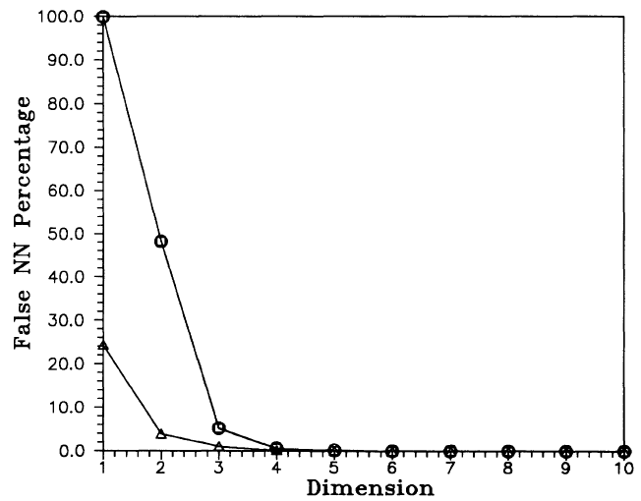
An Example
The percentage of false nearest neighbors for 24000 data points from the Lorenz System

Slide 28
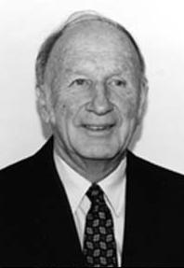
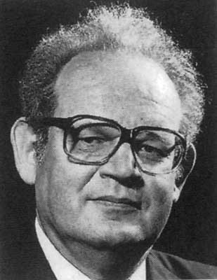
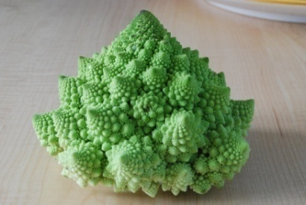
Chaos
Chaos Theory – It’s about the deterministic factors (non-linear relationships) that cause things to look random
Not all the randomness we see is really due to chance, it could well be due to ‘deterministic’ factors
Edward Lorenz
Chaos
Benoit Mandelbrot
Fractal

Slide 29

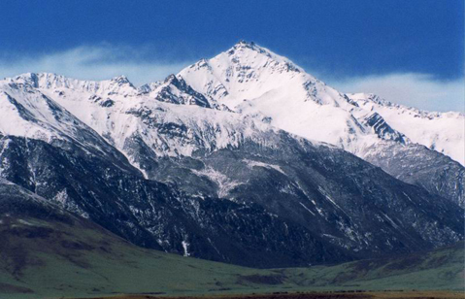
Fractal
Man made structures
Euclidean geometry (>2000 yrs)
Triangles, circles, squares,
rectangles, trapezoids, pentagons,
hexagons, octagons, cylinders
Nature
Rough edges
Non uniform shapes
Fractal geometry (100 yrs)
Self-similarity
All over nature: flowers, trees, mountains, …
Fractals are objects that look the same regardless of the magnification

Slide 30
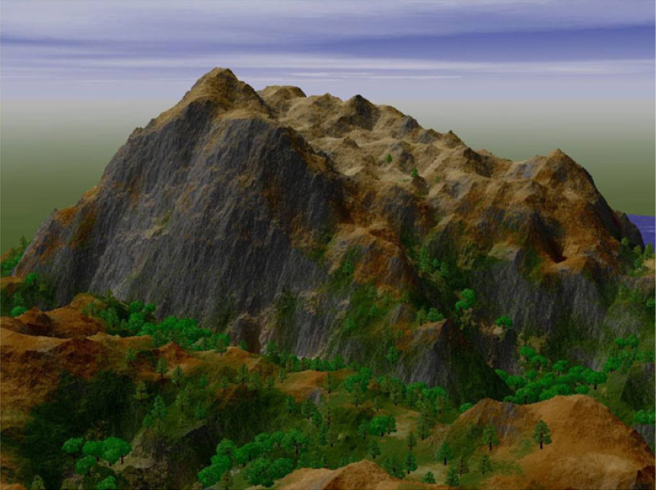
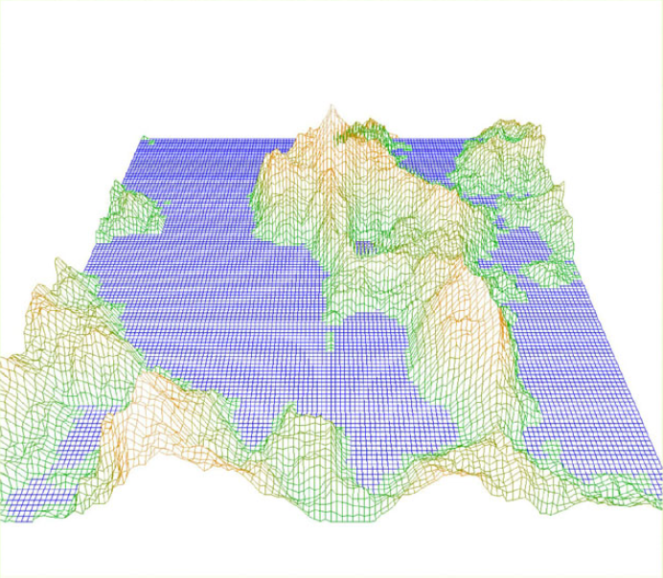
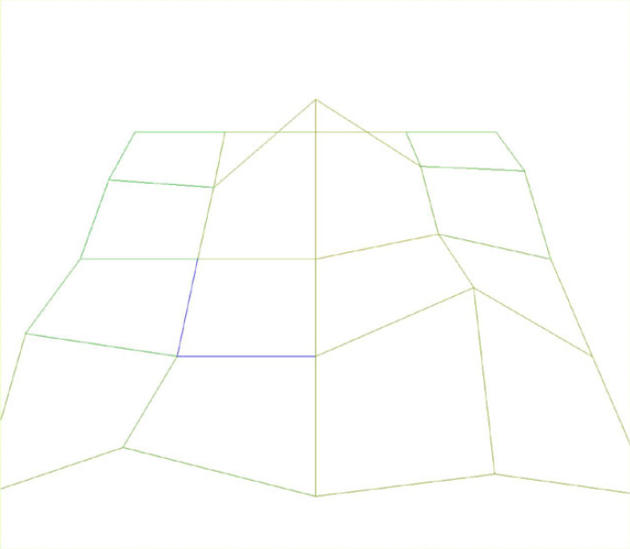
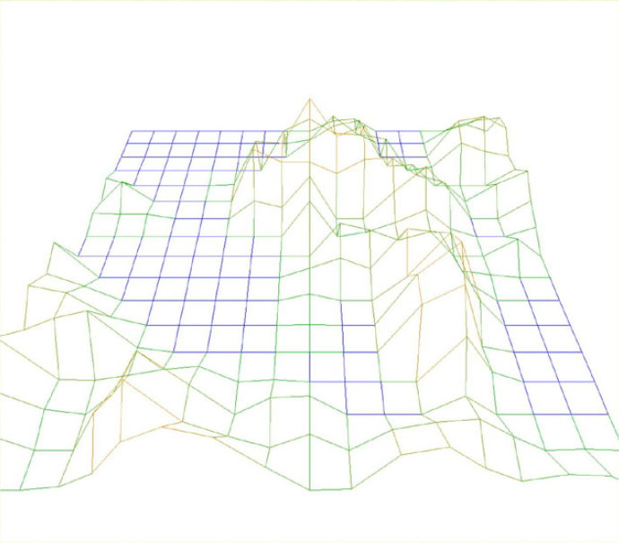
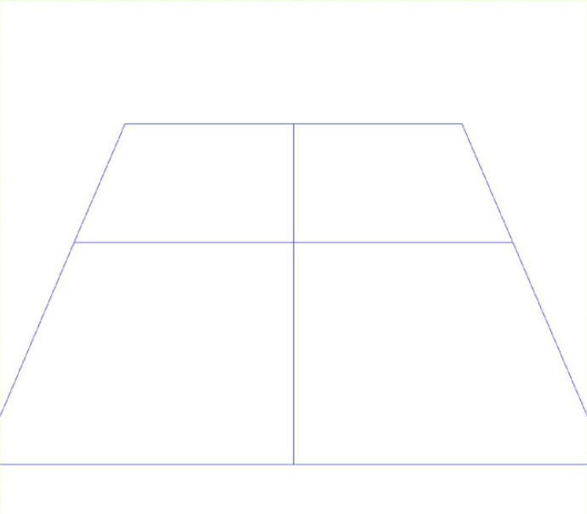

Slide 31
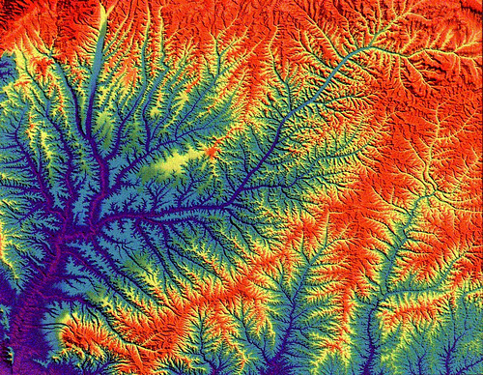

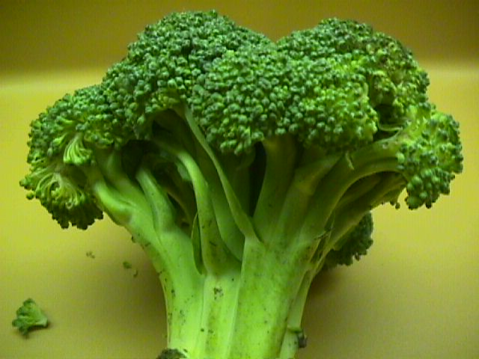

Very Fractal

Slide 32
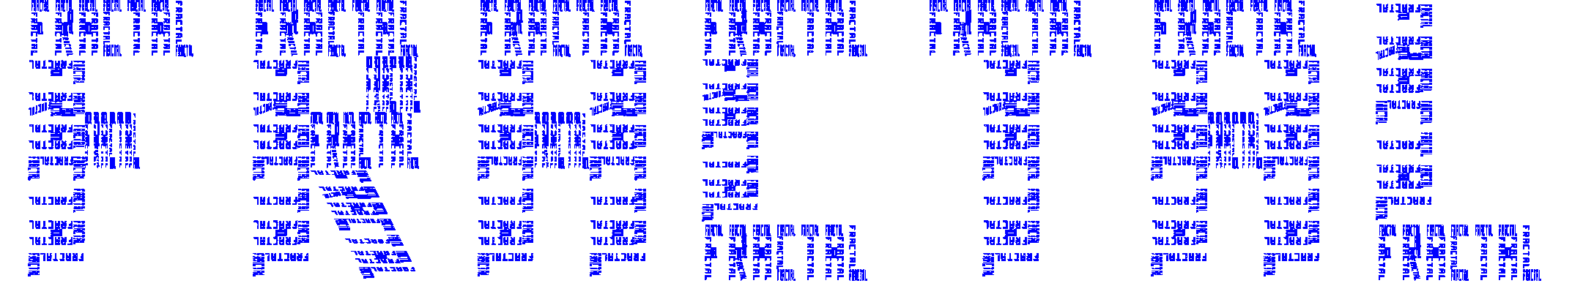
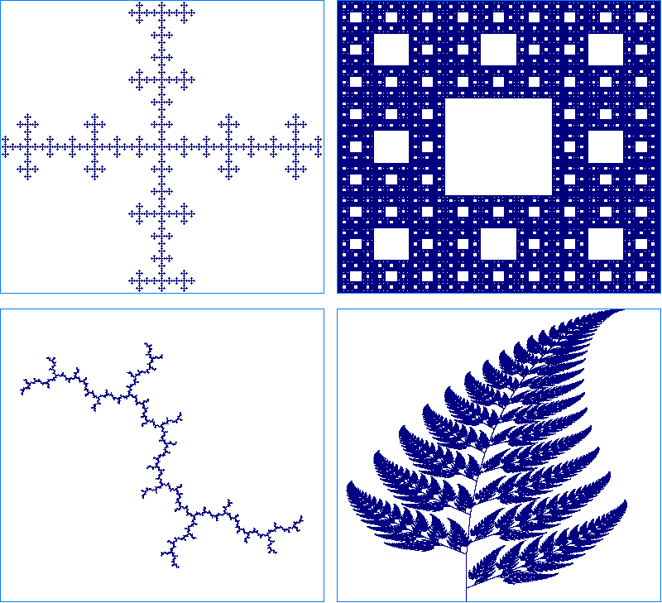
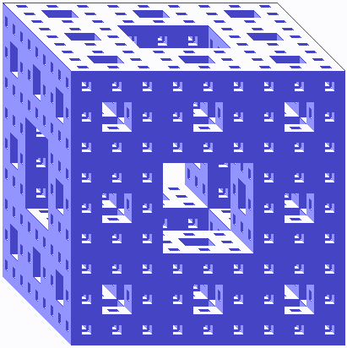

Slide 33
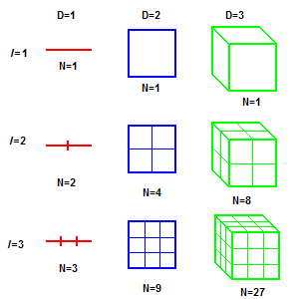
Fractal Dimension
Reduce its linear size by the factor 1/l in each spatial direction
It takes N = l^{D} number of self similar objects to cover the space of original object
D = logN(l)/logl

Slide 34
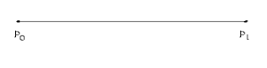
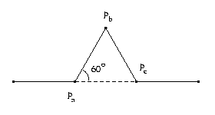
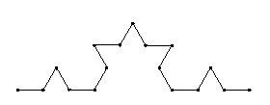
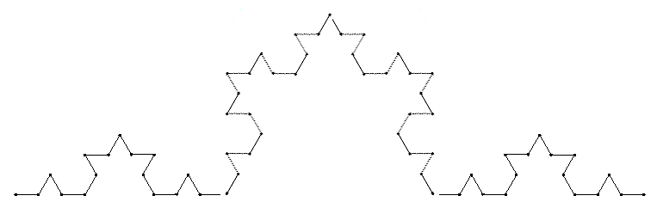
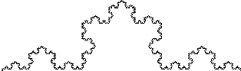
Fractal Dimension
Begin with straight line of length 1
Remove middle 1/3rd and replace with 2 lines with length the same as the other 1/3 lengths
N = l^{D}
What is the fractal dimension?
D = logN(l)/logl
= log4/log3 = 1.2619
1 iteration
4 = 3^{D}
2 iteration
16 = 9^{D}
3 iteration
4 iteration
64 = 27^{D}
5 iteration
256 = 81^{D}

Slide 35
Fractals
Fractals CHANGE the most basic ways we analyze and understand experimental data.
Statistical moments may be zero or infinite.
No Bell Curves
No Moments
No mean ± s.e.m.
Measurements over many scales.
What is real is not one number, but how the measured values change with the scale at which they are measured (fractal dimension).

Slide 36
END Questions?

Slide 37
Ordinary Coin Toss
Toss a coin. If it is tails win $0, If it is heads win $1.
The average winnings are:
2⁻¹*1 = 0.5
1/2
Non-Fractal
Notes:
Let’s play a non-fractal game of chance.
Toss a coin, if it comes up tails we win nothing, if it comes up heads we win $1.
The average winnings are the probability of each outcome times how much we win on that outcome.
The average winnings are (1/2) x ($0) + (1/2) x ($1) = 50 cents.
Let’s go to a fair casino to play this game.
Fair casinos exist only in math textbooks, it means the bank is willing only to break even and not make a profit.
We and the casino think it’s fair for us to be charged 50 cents to play one game.
Seems reasonable, half the time we win nothing, half the time we win a $1, so if it costs 50 cents to play each time, on average, we and the casino will break even.

Slide 38
St. Petersburg Game
Toss a coin. If it is heads win $2, if not, keep tossing it until it falls heads.
If this occurs on the N-th toss we win $2^{N}.
With probability 2^{-N} we win $2^{N}.
H $2
TH $4
TTH $8
TTTH $16
The average winnings are:
2⁻¹2¹ + 2⁻²2² + 2⁻³2³ + . . . =
1 + 1 + 1 + . . . =
Fractal
Notes:
Now, let’s play a fractal game of chance.
This game was invented by Niklaus Bernoulli who lived in St. Petersburg, Russia and published by his uncle Daniel Bernoulli who lived in Germany, about 350 years ago.
Here, we toss a coin UNTIL it comes up heads.
If it comes up heads on the first toss, we win $2.
If it comes up tails first, and then heads on the second toss, we win $4.
If it comes up tails twice, and then heads on the third toss, we win $8.
And so on.
The average winnings are the probability of each outcome times how much we win on that outcome.
The average winnings are (1/2) x ($2) + (1/4) x ($4) + (1/8) x ($8) + (1/16) X ($16) + …. = 1 + 1 + 1 + 1 … = INFINITY
We say to the casino, “Half the time we’ll win $2, the median winnings of this game is $2” because half the time the coin comes up heads on the first toss and we win $2.
“So, we think it is very fair to put up twice the median winnings, $4, to play each game”.
To our surprise, the now angry casino owner says, “No!”
He adds, “The average winnings of this game are INFINITE, you must put up more than all the money in the universe to play this game, even once!”
This game became known as the St. Petersburg Paradox, because we and the casino cannot agree on the fee to play this game.
This game is well known amongst mathematicians, which means its well known amongst the people who know it well.
But, because of its unusually mathematical character, it was not one of the threads of probability theory that was woven into the fabric of statistics that became popular in the natural sciences that is taught in Statistics 101.
Now, with the popularity of fractals, it is being re-discovered and its importance in analyzing and understanding real data increasingly appreciated.

